Slide 1
FRB Update #23
William Huang
(11/21/2020)

Slide 2
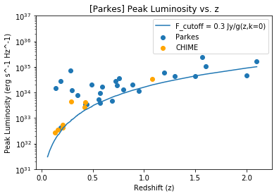
Adding Parkes + CHIME
27 Parkes FRBs, 3 fall under the 0.30 Jy flux limit
8 CHIME FRBs, all above flux limit

Slide 3
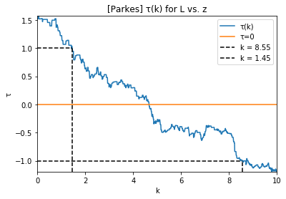
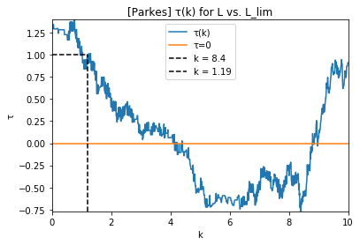
Kendall Tau
~k = 4 for tau=0 using both methods

Slide 4
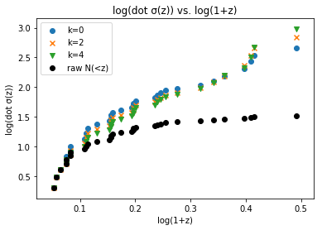
Dot sigma
The dot sigma for k=4 starts out below that of k=0 and k=2, but actually increases around log(1+z) = 0.4.

Slide 5
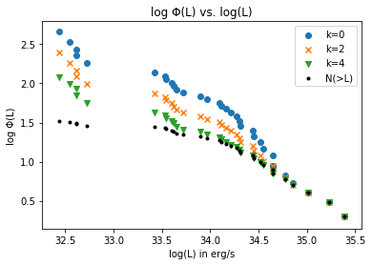
Phi(L) with Parkes + CHIME

Slide 6
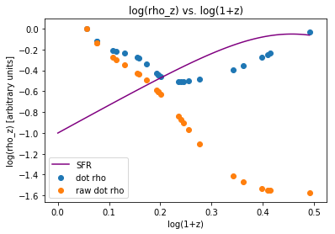
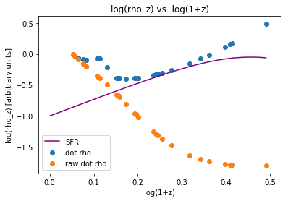
Dot rho(z), with arbitrary units
On the left, the plot of dot rho and raw dot rho are for Parkes only. The right graph includes both Parkes and CHIME data. The star formation rate is taken from Madau and Dickinson 2014, scaled so that the graph occupies the same range.

